Slide 1
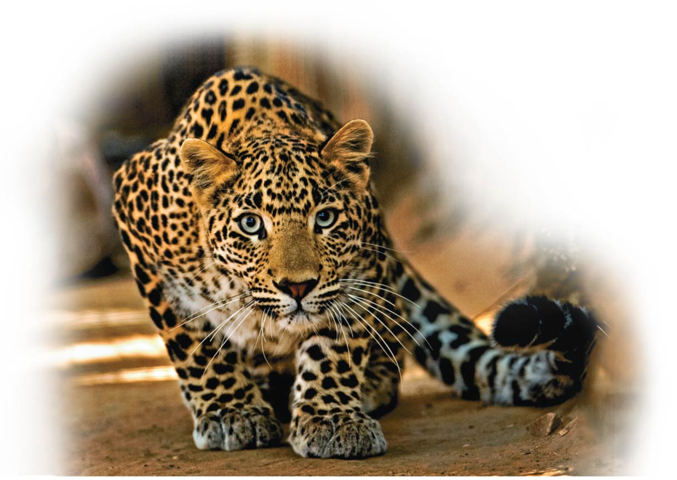
Photosynthesis:
Using Light to Make Food
Unit 1; Chapter 7

Slide 2
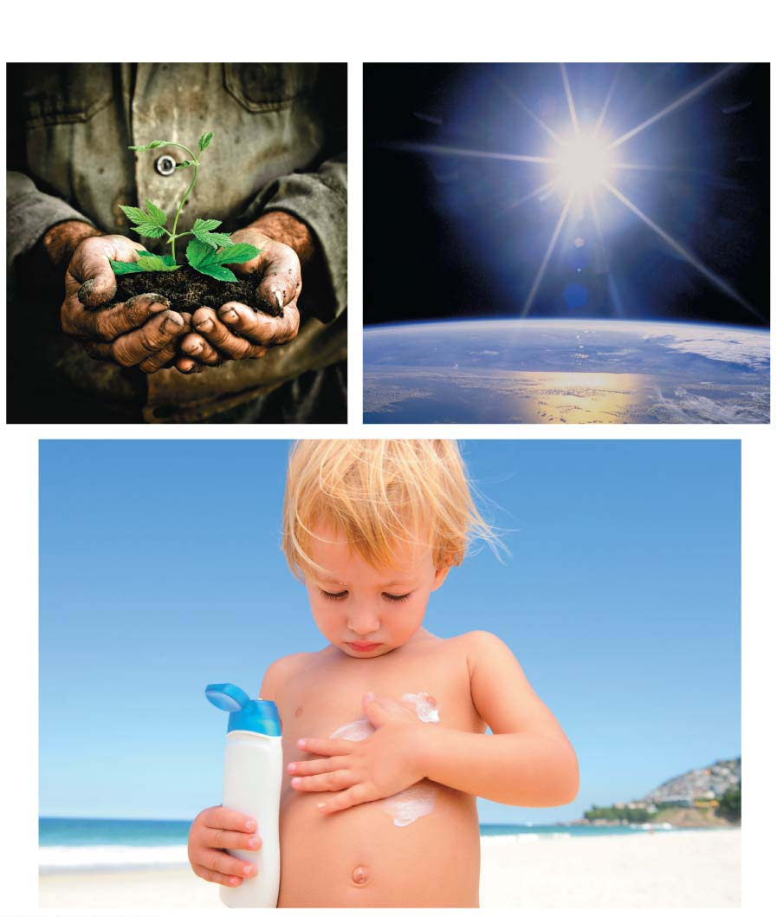
Why Photosynthesis Matters ?
Notes:
Figure 7.0-1 Why photosynthesis matters

Slide 3
Biology and Society: A Greasy Crime Wave
In September 2013, police in Ocala, Florida, arrested two men and charged them with organized fraud and grand theft for stealing more than 700 gallons (2660 L) of used cooking oil pilfered from a variety of local eateries.
Notes:
3

Slide 4
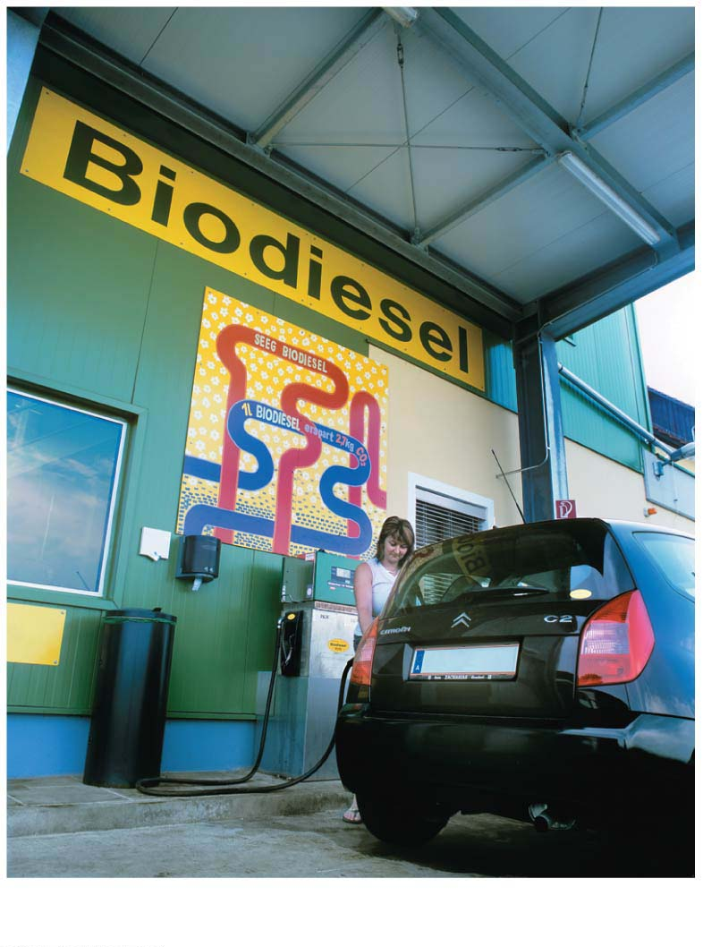
Chapter Thread: Biofuels
Notes:
Figure 7.0-2 Biofuels: using biofuels

Slide 5
Biology and Society: A Greasy Crime Wave
There are several types of biofuels.
Bioethanol（生物乙醇）is a type of alcohol that is made from wheat, corn, sugar beets, and other food crops and can be used directly as a fuel source in specially designed vehicles or as a gasoline additive.
Notes:
5

Slide 6
Biology and Society: A Greasy Crime Wave
Cellulosic ethanol（纤维素乙醇） is a form of bioethanol made from cellulose found in nonedible plant material such as wood, grass, or scraps from crops.
Biodiesel（生物柴油）, the most common biofuel in Europe, is made from plant oils such as recycled frying oil.
Today, only about 2.7% of the world’s fuel used for driving is provided by biofuels, but the International Energy Agency has set of goal of 25% by 2050.
Notes:
6

Slide 7
Biology and Society: A Greasy Crime Wave
Whatever its form, when we derive energy from biofuels, we are actually tapping into the energy of the sun, which drives the process of photosynthesis in plants.
Photosynthesis is the process by which plants use light to make sugars from carbon dioxide—sugars that are
food for the plant and
the starting point for most of our own food.
Notes:
7

Slide 8
The Basics of Photosynthesis
Photosynthesis
is used by plants, algae（藻类）(protists 原生生物), and certain bacteria,
transforms light energy into chemical energy,
uses carbon dioxide and water as starting materials, and
releases oxygen gas as a by-product.
Notes:
8

Slide 9
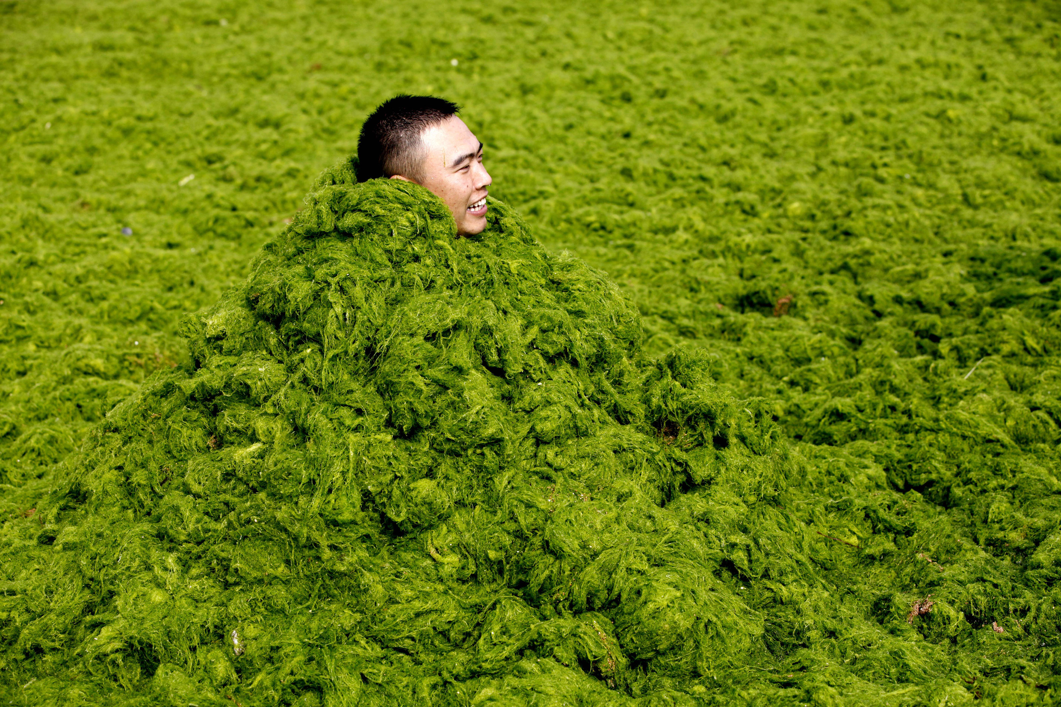
Algae

Slide 10
The Basics of Photosynthesis
The chemical energy produced via photosynthesis is stored in the bonds of sugar molecules.
Organisms that generate their own organic matter from inorganic ingredients are called autotrophs（自养生物）.
Plants and other organisms that do this by photosynthesis—photo-autotrophs（光合自养生物）—are the producers for most ecosystems（生态系统）.
Notes:
10

Slide 11
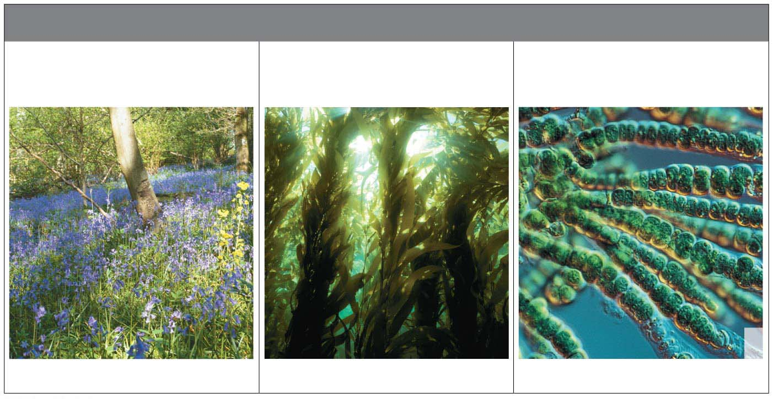
PHOTOSYNTHETIC AUTOTROPHS
Plants
(mostly on land)
Photosynthetic Protists
(aquatic)
Photosynthetic Bacteria
(aquatic)
LM
Forest plants
Kelp(巨藻), a large, multicellular alga（水藻）
Micrograph of cyanobacteria （蓝藻细菌）
Notes:
Figure 7.1 A diversity of photoautotrophs

Slide 12
Chloroplasts: Sites of Photosynthesis
Chloroplasts（叶绿体） are
light-absorbing organelles（细胞器）,
the site of photosynthesis, and
found mostly in the interior cells of leaves.
Their green color is from chlorophyll（叶绿素）, a pigment (light-absorbing molecule) in the chloroplasts that plays a central role in converting solar energy to chemical energy.
Notes:
12

Slide 13
Chloroplasts: Sites of Photosynthesis
Stomata（气孔）are tiny pores in leaves where
carbon dioxide enters and
oxygen exits.
Membranes within the chloroplast form the framework where many of the reactions of photosynthesis occur.
Notes:
13

Slide 14
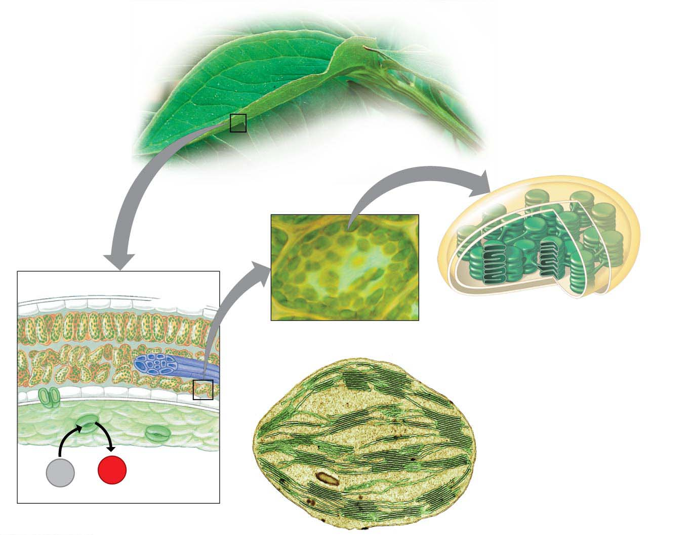
Inner and outer membranes
Photosynthetic
cells
LM
Vein 脉管
Stroma（基质）
Thylakoid（类囊体）
Interior cell
Chloroplast（叶绿体）
Thylakoid
space
Granum
基粒
CO₂
O₂
Stomata
（气孔）
Colorized TEM
Leaf cross section
Notes:
Figure 7.2-s3 Journey into a leaf (step 3)

Slide 15
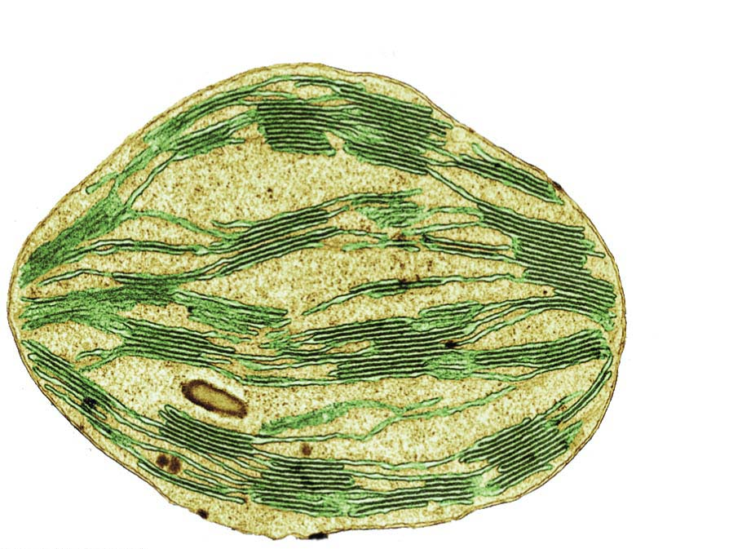
Chloroplast
Granum
Colorized TEM
Notes:
Figure 7.2-2b Journey into a leaf (part 2b: chloroplast, TEM)

Slide 16
Chloroplasts: Sites of Photosynthesis
Like a mitochondrion（线粒体）, a chloroplast has a double-membrane envelope.
The inner membrane encloses a compartment filled with stroma（基质）, a thick fluid.
Suspended in the stroma are interconnected membranous sacs called thylakoids（类囊体）.
The thylakoids are concentrated in stacks called grana (singular, granum（基粒）).
The chlorophyll（叶绿素） molecules that capture light energy are built into the thylakoid membranes.
Notes:
16

Slide 17
Energy Transformations: An Overview of Photosynthesis
In the overall equation for photosynthesis, notice that the reactants of photosynthesis, carbon dioxide (CO₂) and water (H₂O), are the same as the waste products of cellular respiration, and photosynthesis produces what respiration uses—glucose (C₆H₁₂O₆) and oxygen (O₂).
Notes:
17

Slide 18
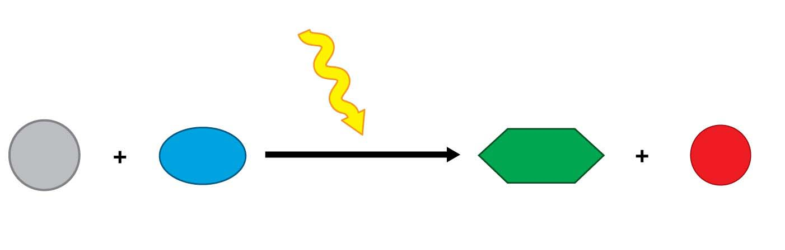
Light energy
6 CO₂
6 H₂O
C₆H₁₂O₆
6 O₂
Photosynthesis
Carbon
dioxide
Water
Glucose
Oxygen gas
Notes:
Figure 7.UN03 Summary of key concepts: photosynthesis equation

Slide 19
Energy Transformations: An Overview of Photosynthesis
Photosynthesis is a chemical transformation that requires a lot of energy, and sunlight absorbed by chlorophyll provides that energy.
Recall that cellular respiration is a process of electron transfer. A “fall” of electrons from food molecules to oxygen to form water releases the energy that mitochondria（线粒体） can use to make ATP.
The opposite occurs in photosynthesis: Electrons are added to carbon dioxide to produce sugar.
Notes:
19

Slide 20
Energy Transformations: An Overview of Photosynthesis
The overall equation for photosynthesis is a simple summary of a complex process.
Like many energy-producing processes within cells, photosynthesis is a multistep chemical pathway, with each step in the path producing products that are used as reactants in the next step.
This is a clear example of one of biology’s major themes: the use of metabolic pathways to obtain, process, and store energy.
Notes:
20

Slide 21
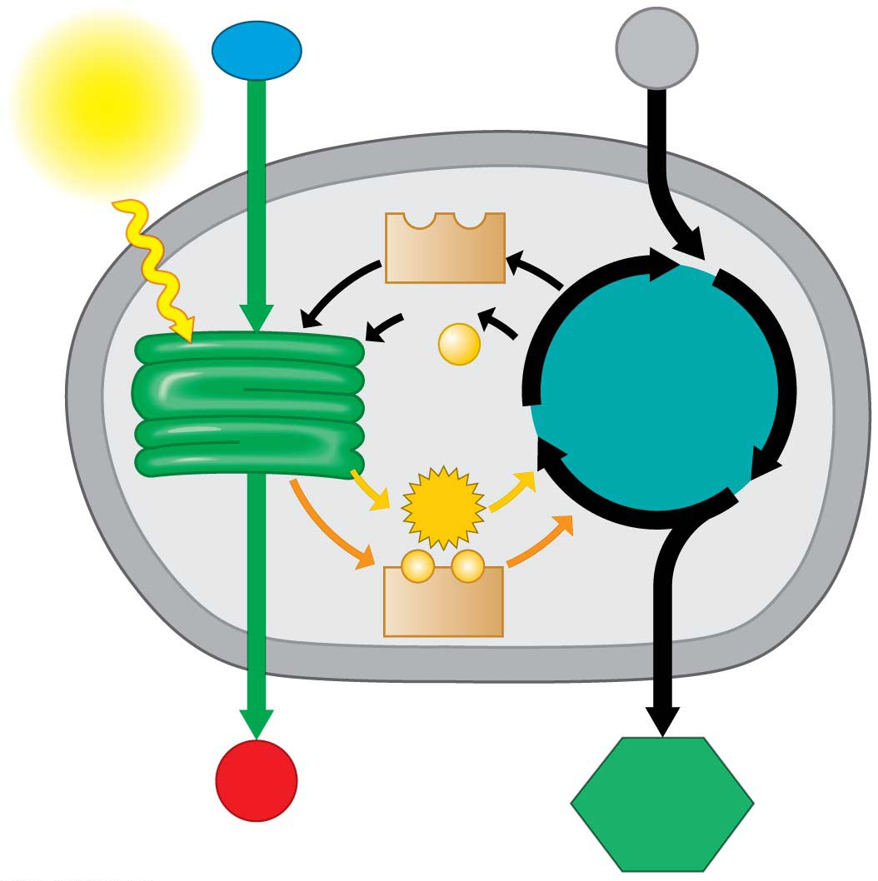
H₂O
Chloroplast
CO₂
Light
NADP⁺
ADP
+
P
Light
reactions
Calvin
cycle
ATP
⁻
⁻
NADPH
O₂
Sugar
Notes:
Figure 7.3-s2 A road map for photosynthesis (step 2)

Slide 22
Energy Transformations: An Overview of Photosynthesis
Photosynthesis occurs in two stages.
In the light reactions,
chlorophyll in the thylakoid membranes absorbs solar energy, which is then converted to the chemical energy of ATP and NADPH, and
water is split, providing a source of electrons and giving off O₂ gas as a by-product.
Notes:
22

Slide 23
Energy Transformations: An Overview of Photosynthesis
The Calvin cycle uses the products of the light reactions to make sugar from carbon dioxide.
ATP generated by the light reactions provides the energy for sugar synthesis.
The NADPH produced by the light reactions provides the high-energy electrons that drive the synthesis of glucose from carbon dioxide.
Thus, the Calvin cycle indirectly depends on light to produce sugar because it requires the supply of ATP and NADPH produced by the light reactions.
Notes:
23

Slide 24
Energy Transformations: An Overview of Photosynthesis
The initial incorporation of carbon from the atmosphere into organic compounds is called carbon fixation.
This can help reduce the concentration of carbon dioxide in the atmosphere.
Notes:
24

Slide 25
Energy Transformations: An Overview of Photosynthesis
Deforestation（采伐森林）, which removes a lot of photosynthetic plant life, thereby reduces the ability of the biosphere to absorb carbon.
Planting new forests can have the opposite effect of fixing carbon from the atmosphere, potentially reducing the effect of the gases that contribute to global climate change.
Notes:
25

Slide 26
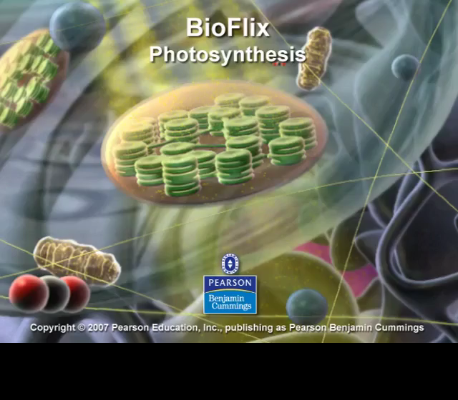
BioFlix Animation: Photosynthesis

Slide 27
The Light Reactions: Converting Solar Energy to Chemical Energy
Chloroplasts are solar-powered sugar factories.
Notes:
27

Slide 28
The Nature of Sunlight
When sunlight shines on a pigmented material, certain wavelengths (colors) of the visible light are absorbed and disappear from the light that is reflected by the material.
In the 19th century, botanists（植物学家） discovered that only certain wavelengths of light are used by plants.
Notes:
28

Slide 29
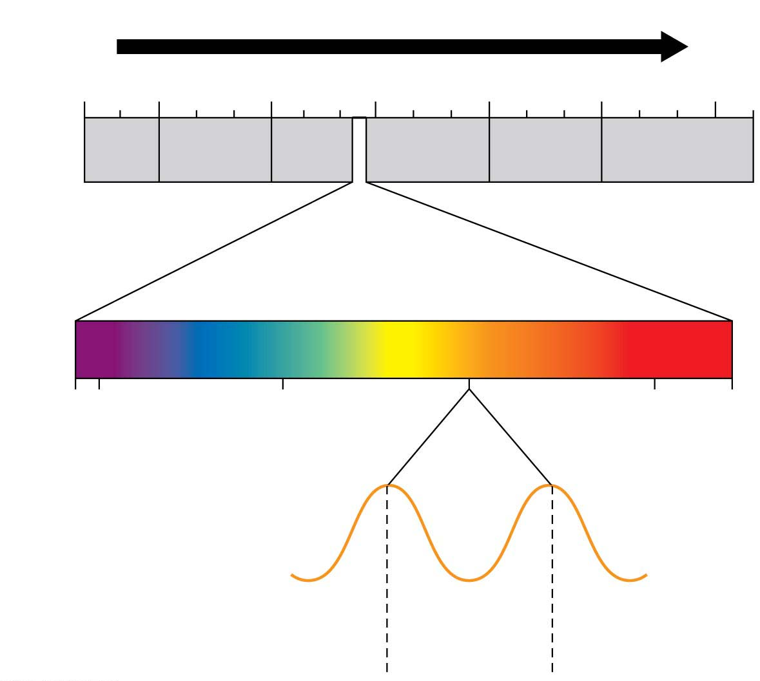
Increasing wavelength
10⁻⁵ nm
10⁻³ nm
1 nm
10³ nm
10⁶ nm
1 m
10³ m
Gamma
rays
X-rays
UV
Infrared
Micro-
waves
Radio
waves
Highest
energy
Lowest
energy
Visible light
380
400
500
600
700
750
Wavelength (nm)
Wavelength =
580
nm
Notes:
Figure 7.4 The electromagnetic spectrum

Slide 30
The Process of Science: What Colors of Light Drive Photosynthesis?
Observation: In 1883, German biologist Theodor Engelmann saw that certain bacteria living in water tend to cluster in areas with higher oxygen concentrations.
Question: Could this information determine which wavelengths of light work best for photosynthesis?
Hypothesis: Oxygen-seeking bacteria will congregate near regions of algae performing the most photosynthesis.
Notes:
30

Slide 31
The Process of Science: What Colors of Light Drive Photosynthesis?
Experiment: Engelmann
laid a string of freshwater algal cells in a drop of water on a microscope slide,
added oxygen-sensitive bacteria to the drop, and
used a prism to create a spectrum of light shining on the slide.
Notes:
31

Slide 32
The Process of Science: What Colors of Light Drive Photosynthesis?
Results:
Most bacteria congregated around algae exposed to red-orange and blue-violet light.
Very few moved to areas of green light.
Other experiments have since verified that
chloroplasts absorb light mainly in the blue-violet and red-orange part of the spectrum and
those wavelengths of light are the ones mainly responsible for photosynthesis.
Notes:
32

Slide 33
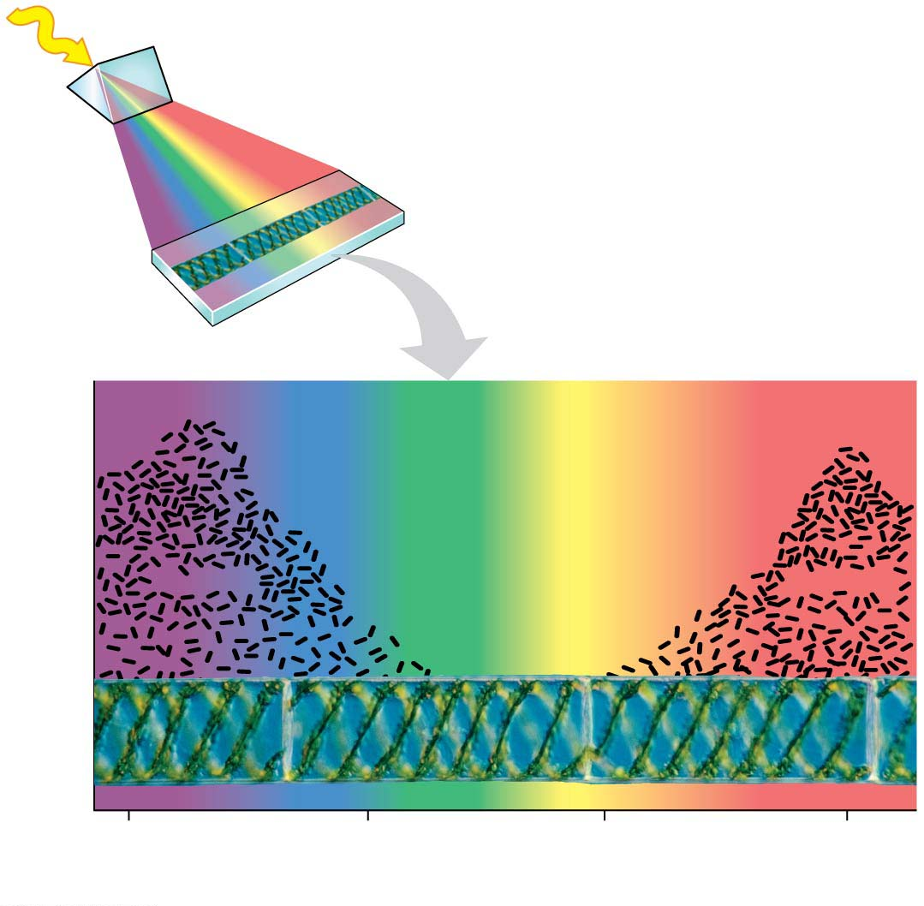
Light
Investigating how light wavelength affects photosynthesis
Prism
Microscope slide
Bacteria
Bacteria
Number of bacteria
Algal cells
400
500
600
700
Wavelength of light (nm)
Notes:
Figure 7.5 Investigating how light wavelength affects photosynthesis

Slide 34
Chloroplast Pigments
The selective absorption of light by leaves explains why they appear green to us.
Light of that color is poorly absorbed by chloroplasts and is thus reflected or transmitted toward the observer.
Energy cannot be destroyed, so the absorbed energy must be converted to other forms.
Notes:
34

Slide 35
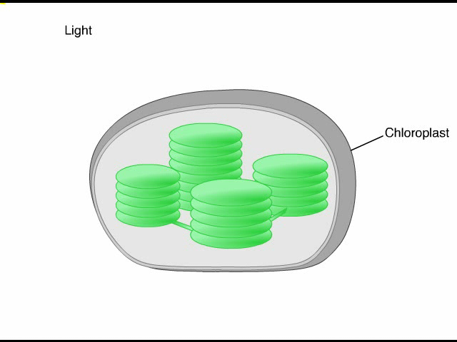
Animation: Light and Pigments

Slide 36
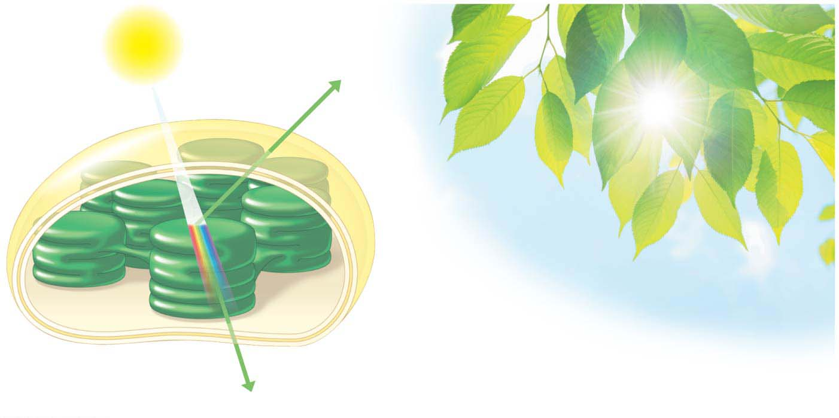
Light
Reflected
light
Chloroplast
Absorbed
light
Transmitted
light (detected
by your eye)
Notes:
Figure 7.6 Why are leaves green?

Slide 37
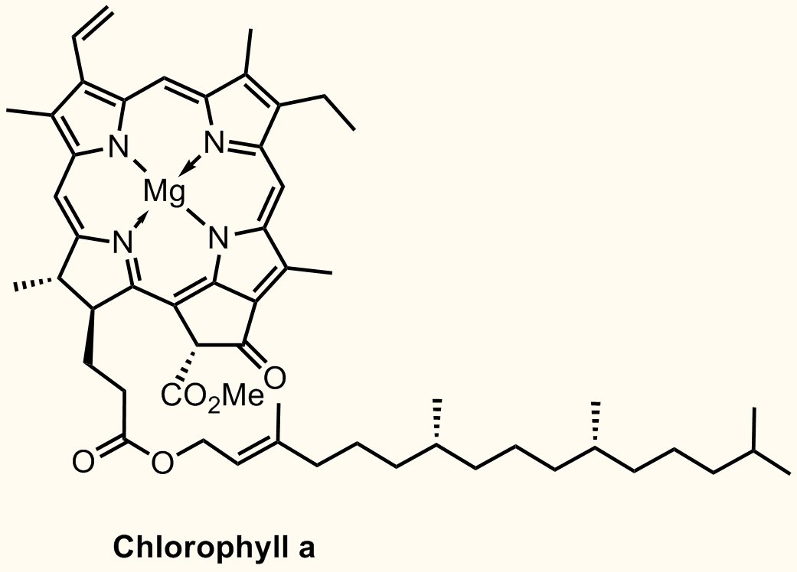
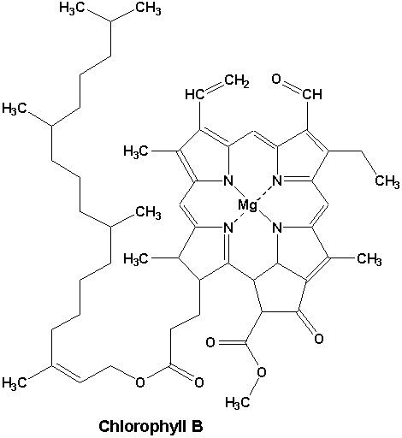
Chloroplast Pigments
Chloroplasts contain several different pigments that absorb light of different wavelengths.
Chlorophyll a
participates directly in the light reactions and
absorbs mainly blue-violet and red light.
Chlorophyll b
is very similar to chlorophyll a,
absorbs mainly blue and orange light, and
conveys absorbed energy to chlorophyll a.
Notes:
37

Slide 38
Chloroplast Pigments
Carotenoids（类胡萝卜素）
absorb mainly blue-green light and
absorb and dissipate excessive light energy that might damage chlorophyll.
Notes:
38

Slide 39
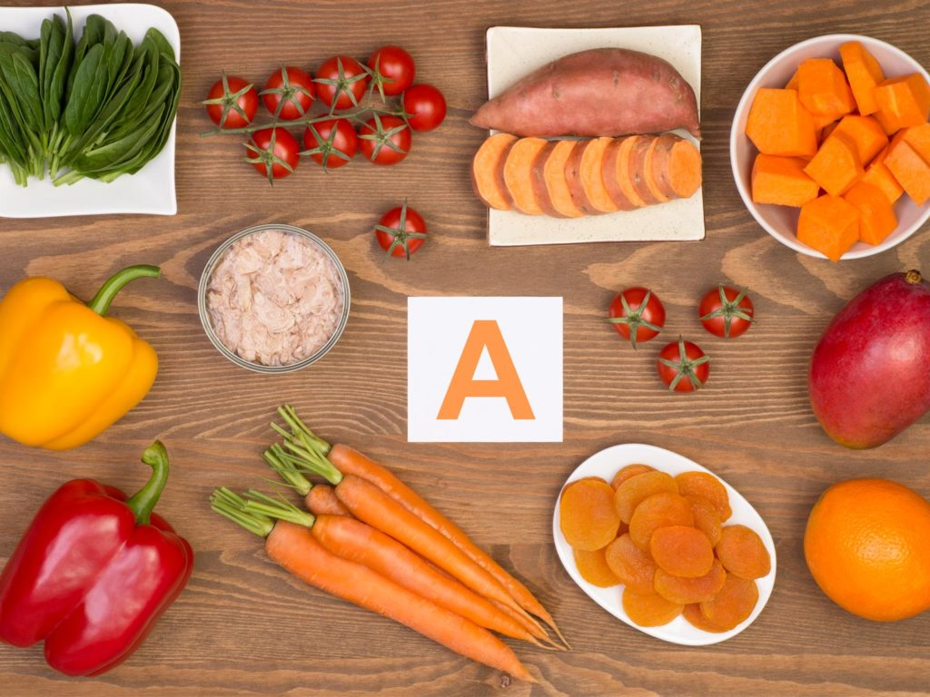
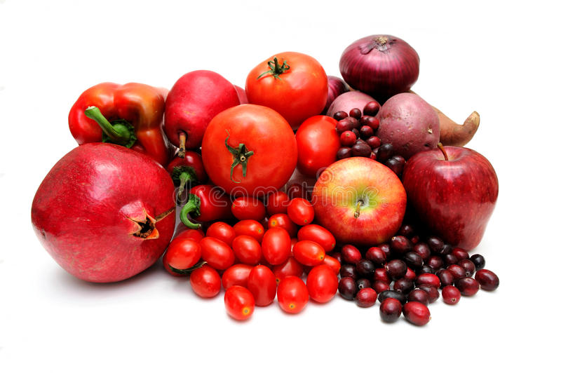
Chloroplast Pigments
Some carotenoids are human nutrients.
Beta-carotene
is a bright orange/red pigment found in pumpkins, sweet potatoes, and carrots and
is converted to vitamin A in the body.
Lycopene（番茄红素）
is a bright red pigment found in tomatoes, watermelon, and red peppers and
is an antioxidant（抗氧化剂） that is being studied for potential anti-cancer properties.
Notes:
39

Slide 40
Chloroplast Pigments
The spectacular colors of fall foliage（树叶） are due partly to the yellow-orange light reflected from carotenoids.
The decreasing temperatures in autumn cause a decrease in the levels of chlorophyll.
This allows the colors of the longer-lasting carotenoids（类胡萝卜素） to be seen in all their fall glory.
Notes:
40

Slide 41
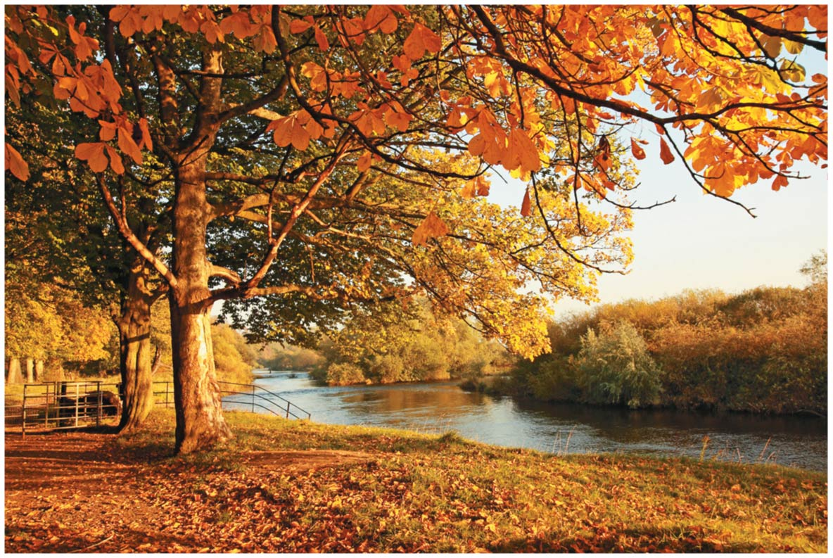
Notes:
Figure 7.7 Photosynthetic pigments

Slide 42
How Photosystems Harvest Light Energy
Light behaves as
waves and
discrete packets of energy called photons（光子）, fixed quantities of light energy.
The shorter the wavelength of light, the greater the energy of a photon.
Notes:
42

Slide 43
How Photosystems Harvest Light Energy
When a pigment molecule absorbs a photon, one of the pigment’s electrons gains energy.
This electron is now said to be “excited.”
The excited state is highly unstable.
An excited electron usually loses its excess energy and falls back to its ground state almost immediately.
Most pigments release heat energy as their light-excited electrons fall back to their ground state.
Notes:
43

Slide 44
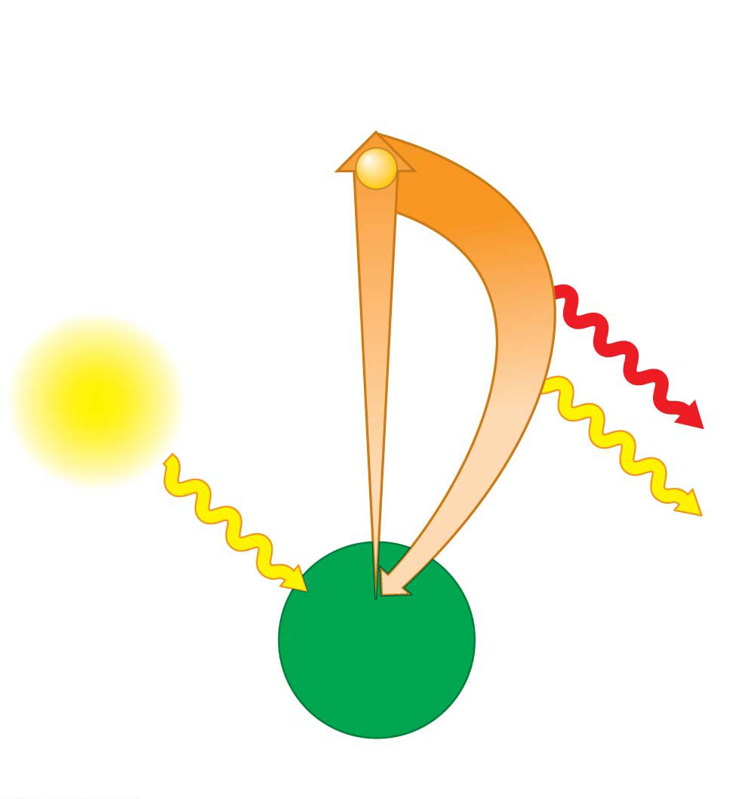
Excited state
The electron
falls to its
ground state.
Absorption of a
photon excites
an electron.
e⁻
Heat
Light
Light
(fluorescence荧光)
Photon
Ground
state
Chlorophyll
molecule
(a) Absorption of a photon
Notes:
Figure 7.8-1 Excited electrons in pigments (part 1: absorption)

Slide 45
How Photosystems Harvest Light Energy
Some pigments emit light as well as heat after absorbing photons.
The fluorescent light emitted by a glow stick is caused by a chemical reaction that excites electrons of a fluorescent dye.
The excited electrons quickly fall back down to their ground state, releasing energy in the form of fluorescent light.
Notes:
45

Slide 46
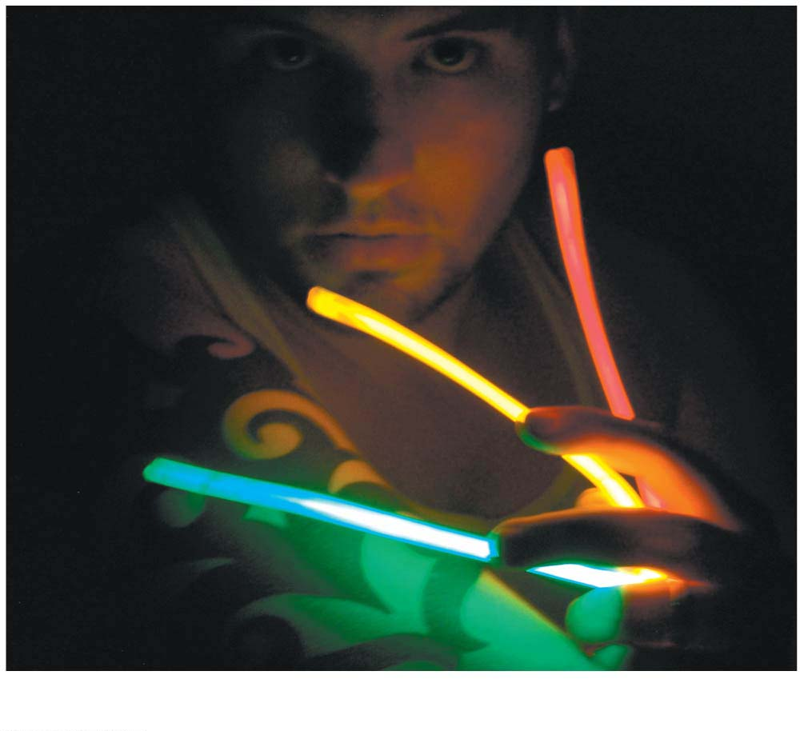
Figure 7.8-2
(b) Fluorescence of a glow stick
Notes:
Figure 7.8-2 Excited electrons in pigments (part 2: fluorescence)

Slide 47
How Photosystems Harvest Light Energy
In the thylakoid membrane, chlorophyll molecules are organized with other molecules into photosystems.
Each photosystem has a cluster of a few hundred pigment molecules, including chlorophylls a and b, and some carotenoids.
Notes:
47

Slide 48
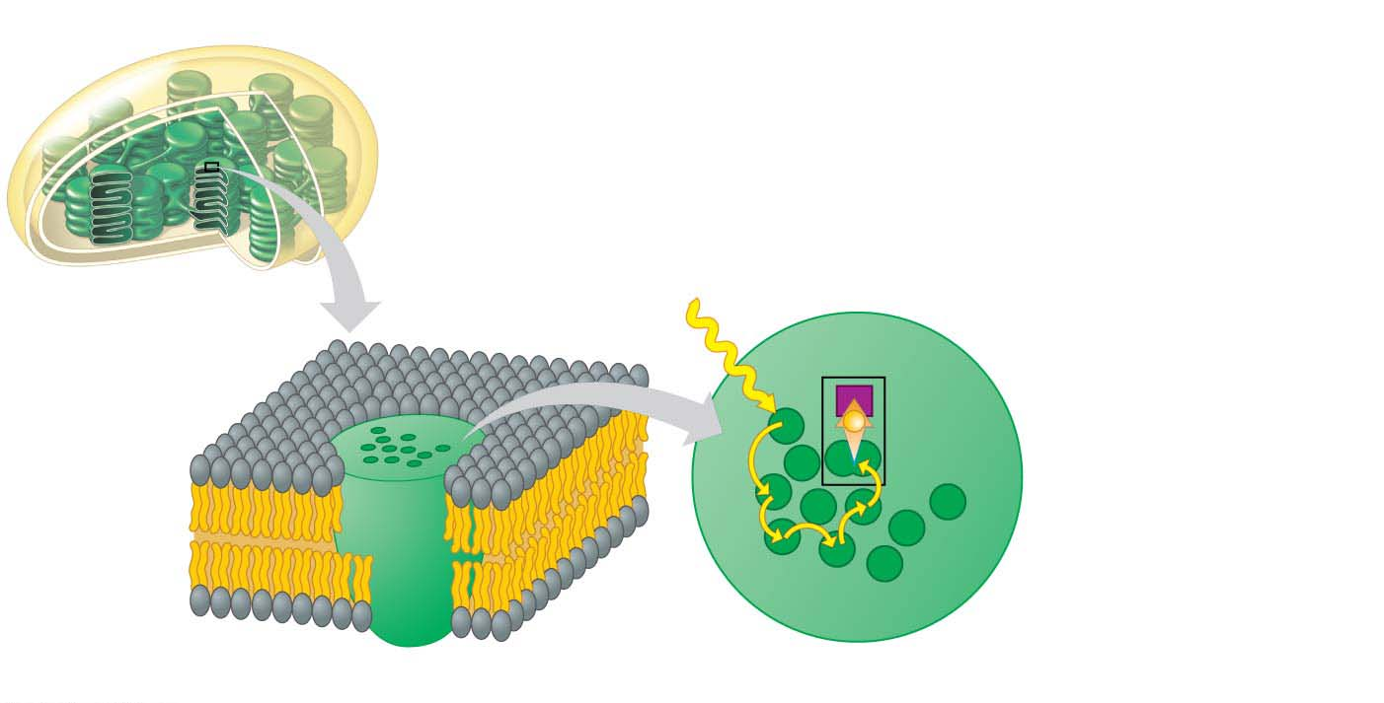
Chloroplast
Cluster of pigment
molecules
Photon
Primary
electron
acceptor
Reaction
center
Electron
transfer
e⁻
Reaction-
center
chlorophyll a
Pigment
molecules
Transfer
of energy
Thylakoid membrane
Photosystem
Notes:
Figure 7.9 A photosystem: light-gathering molecules that focus light energy onto a reaction center

Slide 49
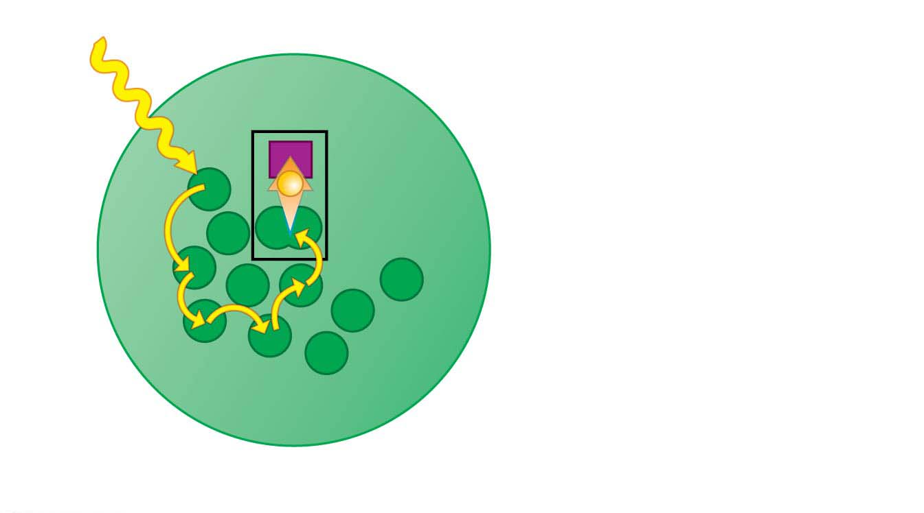
Photon
Primary
electron
acceptor
Electron
transfer
e⁻
Reaction
center
Reaction-
center
chlorophyll a
Pigment
molecules
Transfer
of energy
Photosystem
Notes:
Figure 7.9-2 A photosystem: light-gathering molecules that focus light energy onto a reaction center (part 2: photosystem)

Slide 50
How Photosystems Harvest Light Energy
This cluster of pigment molecules functions as a light-gathering antenna.
When a photon strikes one of the pigment molecules, the energy jumps from molecule to molecule until it arrives at the reaction center of the photosystem.
The reaction center consists of chlorophyll a molecules that sit next to a primary electron acceptor, which traps the light-excited electron from the chlorophyll a in the reaction center.
Another team of molecules built into the thylakoid membrane then uses that trapped energy to make ATP and NADPH.
Notes:
50

Slide 51
How the Light Reactions Generate ATP and NADPH
Two photosystems cooperate in the light reactions:
Photons excite electrons in the chlorophyll of the first photosystem.
These photons are then trapped by the primary electron acceptor.
This photosystem then replaces the lost electrons by extracting new ones from water.
This is the step that releases O₂ during photosynthesis.
Notes:
51

Slide 52
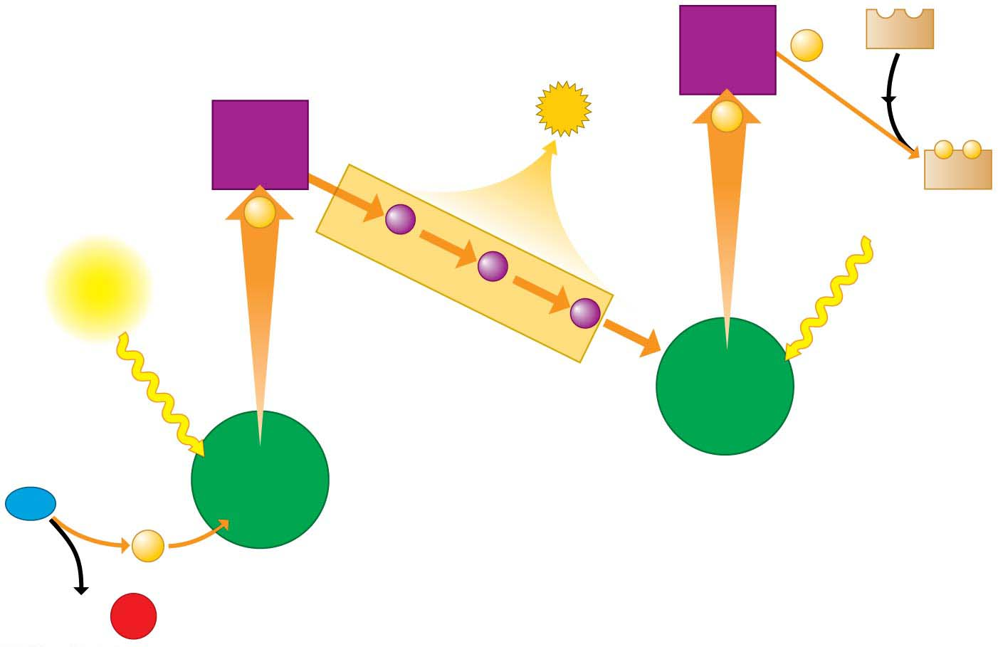
Figure 7.10
Primary
electron
acceptor
NADP⁺
2e⁻
Energy
to make
ATP
3
Primary
electron
acceptor
2e⁻
2
−
−
NADPH
2e⁻
Light
Light
Electron transport chain
Reaction-
center
chlorophyll
1
1
Reaction-
center
chlorophyll
Second
photosystem
H₂O
2e⁻
First
photosystem
2 H⁺ +
¹
²
O₂
Notes:
Figure 7.10 The light reactions of photosynthesis

Slide 53
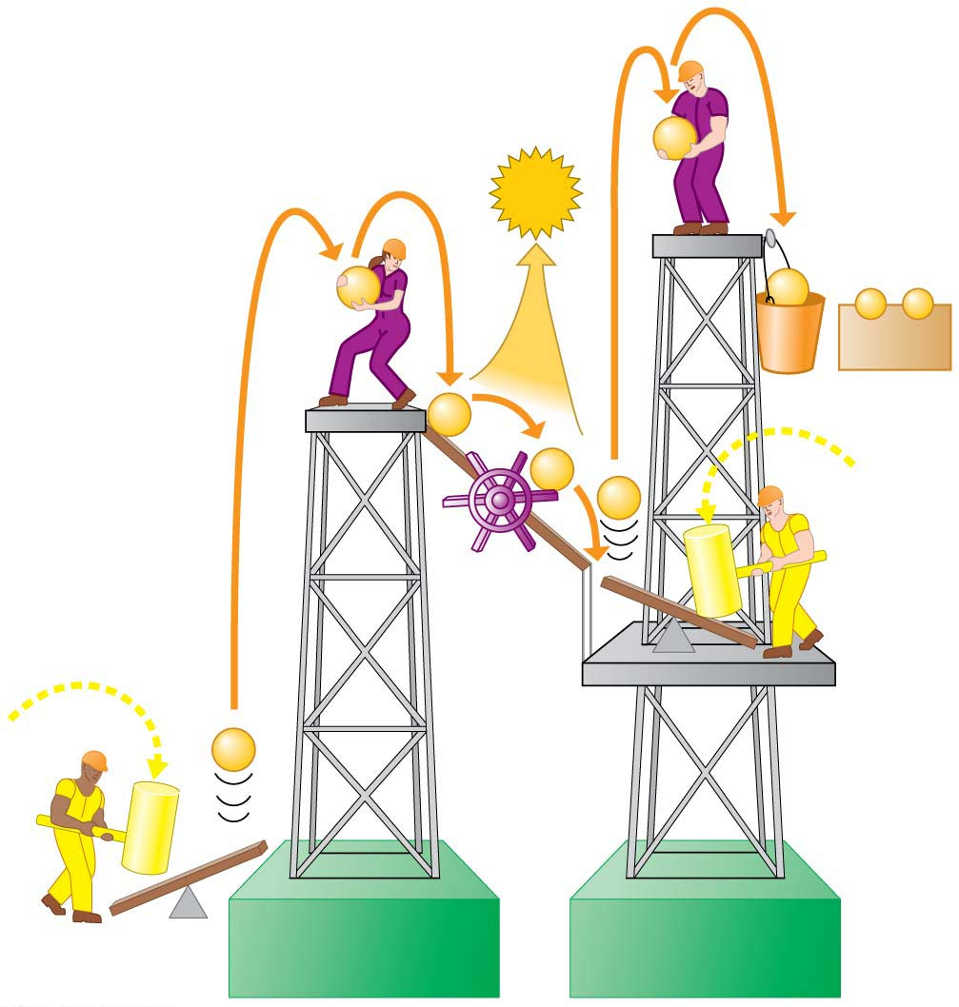
e⁻
ATP
e⁻
e⁻
−
−
NADPH
e⁻
e⁻
e⁻
Electron
transport
chain
Photon
e⁻
Photon
First
photosystem
Second
photosystem
Notes:
Figure 7.12 The light reactions illustrated using a hard-hat analogy

Slide 54
How the Light Reactions Generate ATP and NADPH
Energized electrons from the first photosystem pass down an electron transport chain to the second photosystem. The chloroplast uses the energy released by this electron “fall” to make ATP.
The second photosystem transfers its light-excited electrons to NADP⁺, reducing it to NADPH.
Notes:
54

Slide 55
How the Light Reactions Generate ATP and NADPH
The light reactions are located in the thylakoid membrane.
The two photosystems and the electron transport chain that connects them transfer electrons from H₂O to NADP⁺, producing NADPH.
Notes:
55

Slide 56
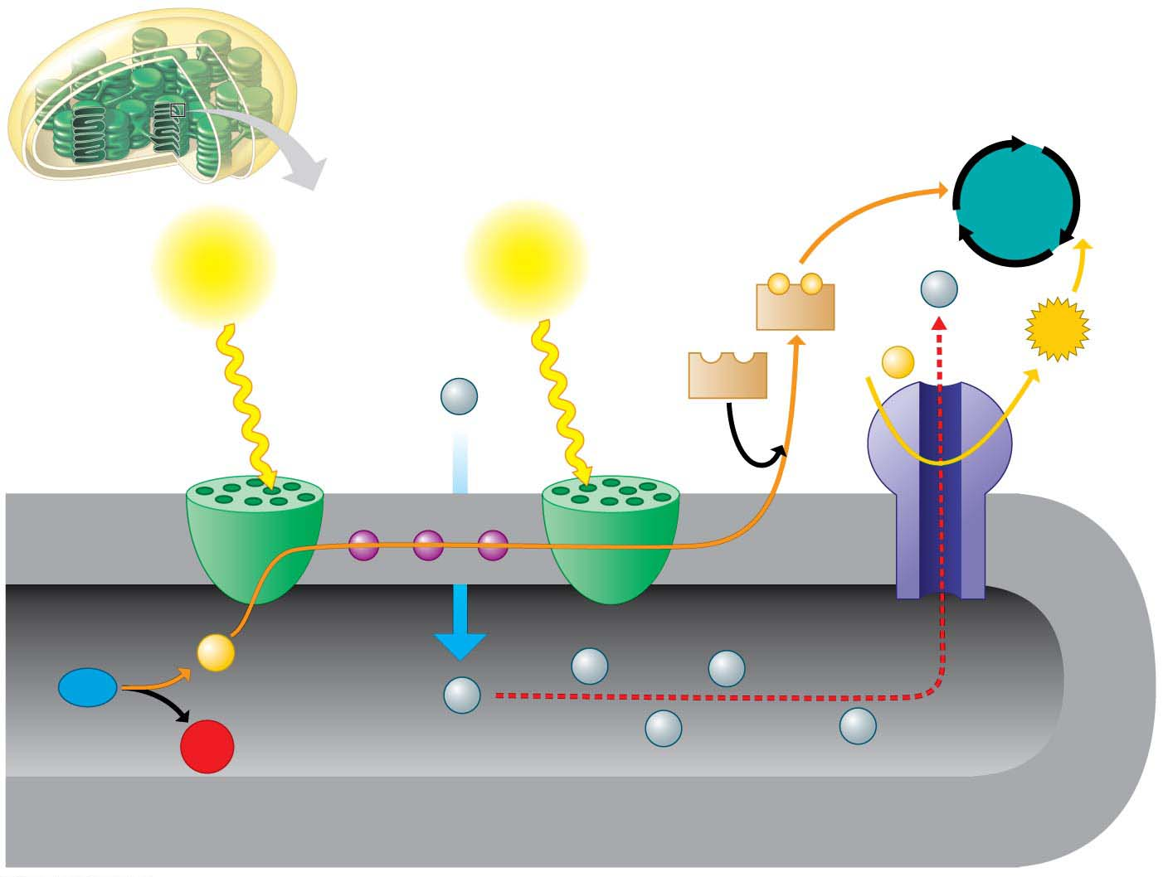
Calvin
cycle
Light
Light
−
−
H⁺
NADPH
ATP
+
ADP
P
NADP⁺
H⁺
Stroma
Electron
transport chain
Thylakoid
membrane
Photosystem
Photosystem
ATP
Synthase
（合成酶）
Inside thylakoid
Electron flow
2e⁻
H⁺
H⁺
H₂O
H⁺
1
2
H⁺
H⁺
O₂
Thylakoid
membrane
Notes:
Figure 7.11 How the thylakoid membrane converts light energy to the chemical energy of NADPH and ATP

Slide 57
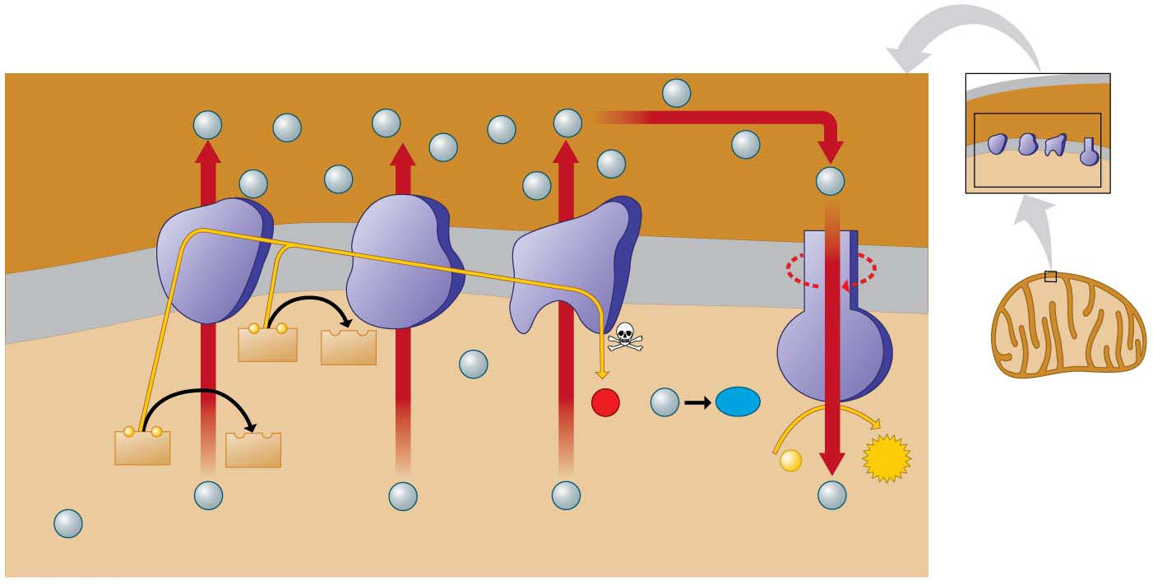
Mitochondrial Electron Transport Chain and ATP Synthesis
Space
between
membranes
H⁺
H⁺
H⁺
H⁺
H⁺
H⁺
H⁺
Electron
carrier
H⁺
H⁺
H⁺
3
H⁺
H⁺
Protein
complex
H⁺
H⁺
5
Inner
mitochondrial（线粒体的）
membrane
−
−
FADH₂
FAD
Electron
flow
2
H⁺
1
H₂O
O₂
H⁺
6
2
2
−
−
4
NADH
NAD⁺
+
ATP
ADP
P
1
H⁺
H⁺
H⁺
H⁺
H⁺
Matrix
Electron transport chain
ATP synthase
Notes:
Figure 6.10 How electron transport drives ATP synthase machines

Slide 58
How the Light Reactions Generate ATP and NADPH
The mechanism of ATP production during the light reactions is very similar to the mechanism we saw in cellular respiration. In both cases,
an electron transport chain pumps hydrogen ions across a membrane and
ATP synthases use the energy stored by the H⁺ gradient to make ATP.
The main difference is that food provides the high-energy electrons in cellular respiration, whereas light-excited electrons flow down the transport chain during photosynthesis.
Notes:
58

Slide 59
The Calvin Cycle: Making Sugar from Carbon Dioxide
The Calvin cycle
functions like a sugar factory within a chloroplast and
regenerates the starting material with each turn.
Notes:
59

Slide 60
The Calvin Cycle: Making Sugar from Carbon Dioxide
With each turn of the cycle, there are chemical inputs and outputs.
The inputs are
CO₂ from the air and
ATP and NADPH produced by the light reactions.
Notes:
60

Slide 61
The Calvin Cycle: Making Sugar from Carbon Dioxide
The Calvin cycle constructs an energy-rich sugar molecule called glyceraldehyde 3-phosphate (G3P)（三磷酸甘油醛）using
carbon from CO₂,
energy from ATP, and
high-energy electrons from NADPH.
The plant cell can then use G3P as the raw material to make
glucose and
other organic compounds.
Notes:
61

Slide 62
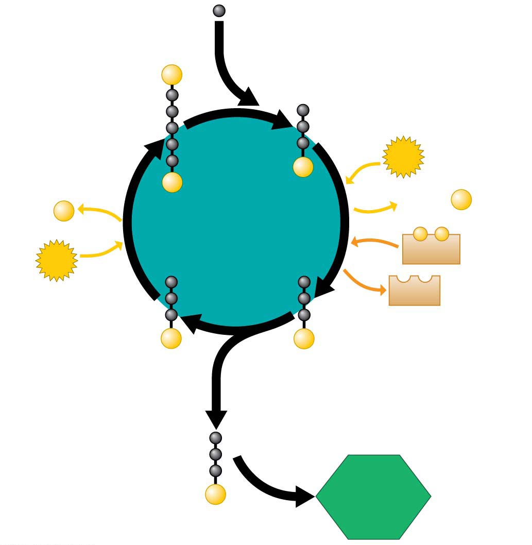
The Calvin Cycle
CO₂ (from air)
1
1
P
RuBP sugar
Three-carbon molecule
4
ATP
P
P
+
Calvin
cycle
ADP
+
P
ADP
P
−
−
ATP
NADPH
NADP⁺
G3P sugar
G3P sugar
3
P
P
2
3
2
G3P sugar
Glucose
(and other
organic
compounds)
P
Notes:
Figure 7.13-s4 The Calvin cycle (step 4)

Slide 63
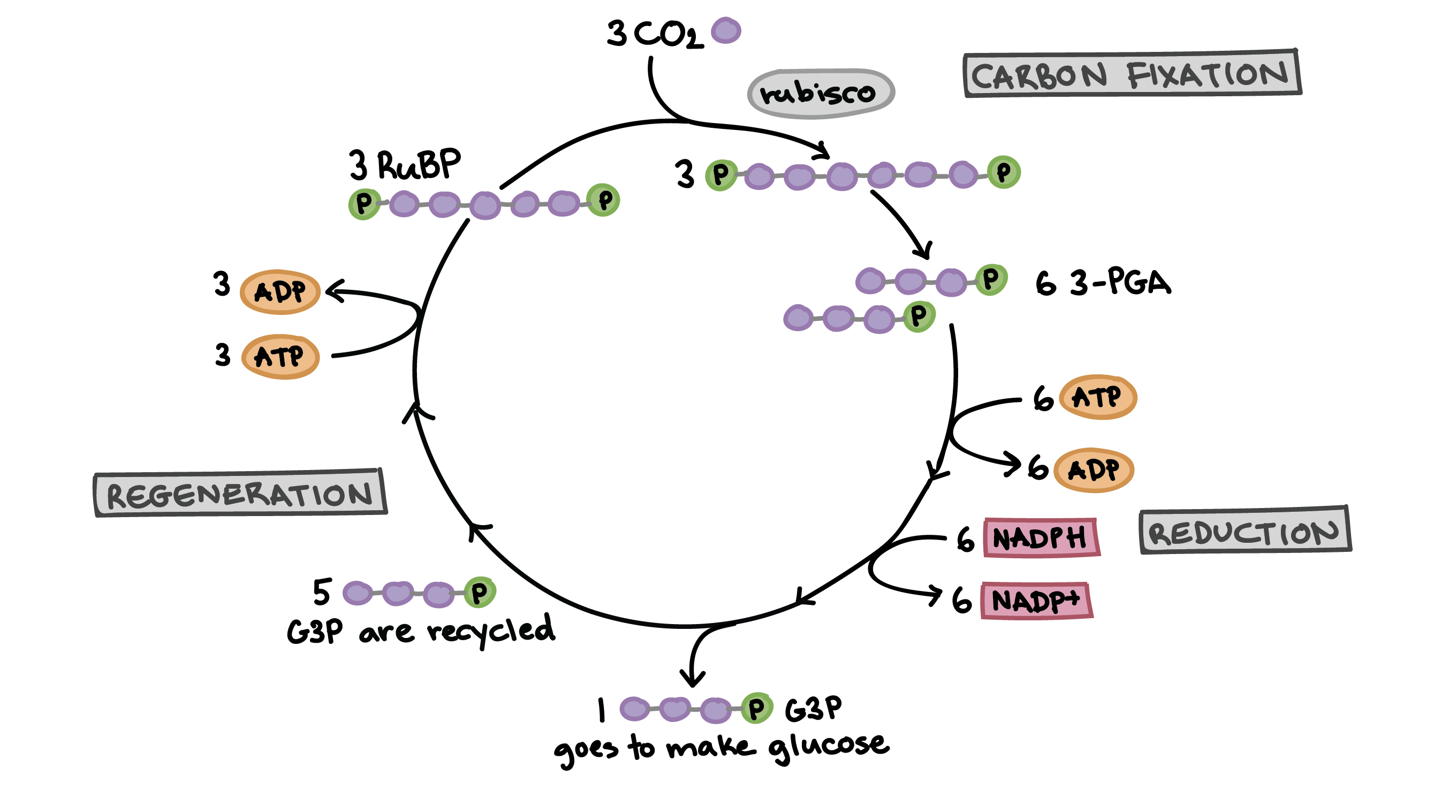
The Calvin Cycle

Slide 64
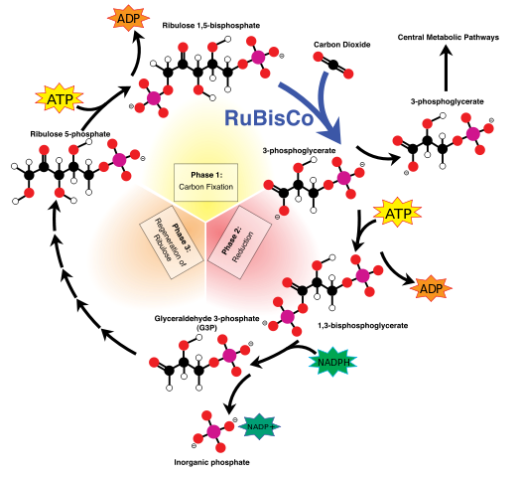
The Calvin Cycle

Slide 65
Evolution Connection: Creating a Better Biofuel Factory
The production of biofuels is highly inefficient. It is usually far more costly to produce biofuels than to extract the equivalent amount of fossil fuels.
Notes:
65

Slide 66
Evolution Connection: Creating a Better Biofuel Factory
Biomechanical engineers are working to solve this dilemma by turning to an obvious example: evolution by natural selection.
In nature, organisms with genes that make them better suited to their local environment will, on average, more often survive and pass those genes to the next generation.
Repeated over many generations, genes that enhance survival within that environment will become more common, and the species evolves.
Notes:
66

Slide 67
Evolution Connection: Creating a Better Biofuel Factory
When trying to solve an engineering problem, scientists can impose their own desired outcomes using a process called directed evolution, in which scientists in the laboratory determine which organisms are the fittest.
Directed evolution of biofuel production often involves microscopic algae rather than plants because algae are easier to manipulate and maintain within the laboratory.
Notes:
67

Slide 68
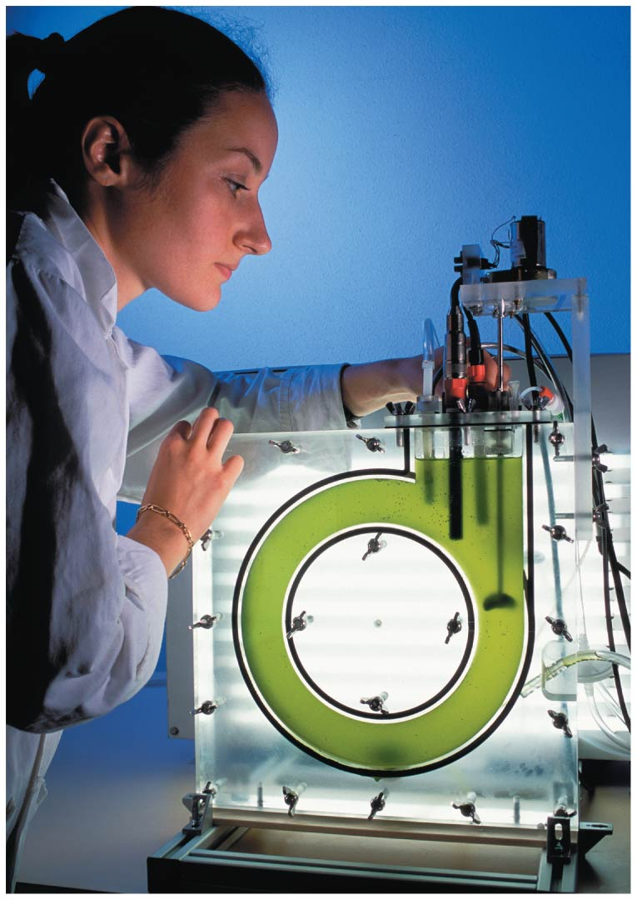
Figure 7.14
Notes:
Figure 7.14 Microscopic biofuel factories

Slide 69
Evolution Connection: Creating a Better Biofuel Factory
In a typical directed evolution experiment, the researcher starts with a large collection of individual alga, sometimes naturally occurring species and sometimes transgenic algae that have been engineered to carry useful genes, such as fungal genes for enzymes that break down cellulose（纤维素）.
Notes:
69

Slide 70
Evolution Connection: Creating a Better Biofuel Factory
The algae are exposed to mutation-promoting chemicals. This produces a highly varied collection of algae that can be screened for the desired outcome: the ability to produce the most useful biofuel in the largest quantity.
The tiny fraction of total algae that can best perform this task is grown and subjected to another round of mutation and selection.
Repeated many times, the algae may slowly improve their ability to efficiently produce biofuels.
Notes:
70

Slide 71
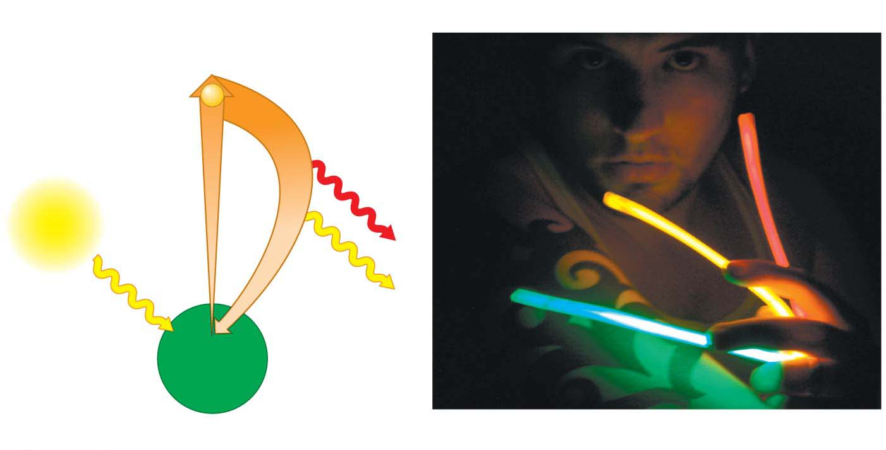
Excited state
The electron
falls to its
ground state.
Absorption of a
photon excites
an electron.
e⁻
Heat
Light
Light
(fluorescence)
Photon
Ground
state
Chlorophyll
molecule
(a) Absorption of a photon
(b) Fluorescence of a glow stick
Notes:
Figure 7.8 Excited electrons in pigments

Slide 72
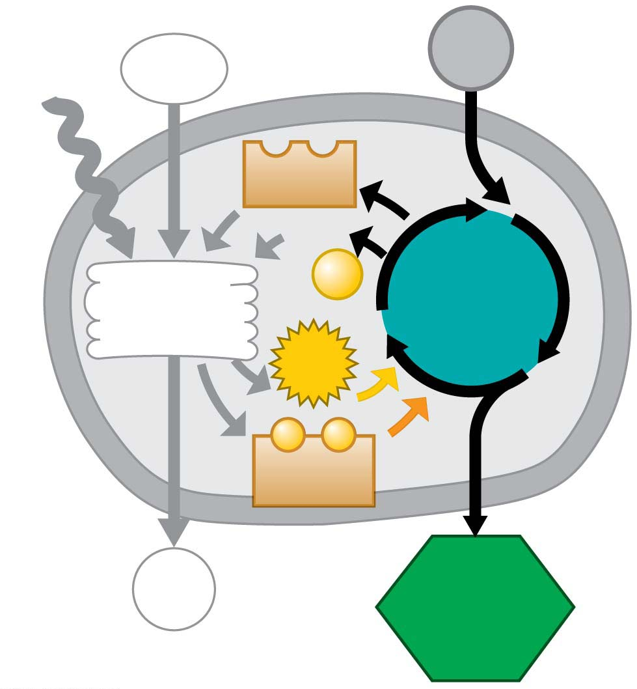
CO₂
Light
H₂O
NADP⁺
ADP
Light
reactions
+
P
Calvin
cycle
ATP
−
−
NADPH
O₂
Sugar
Notes:
Figure 7.UN02 In-text figure, Calvin cycle, p. 115

Slide 73
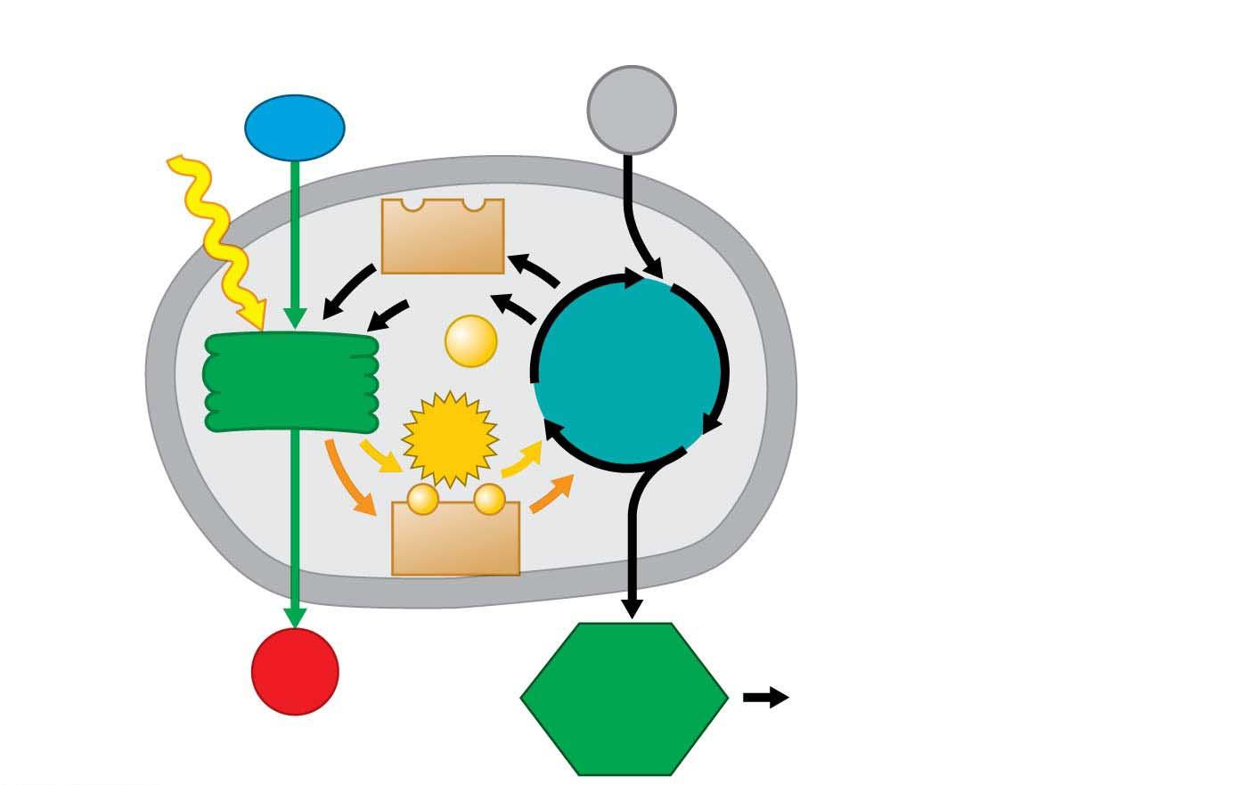
Chloroplast
Light
H₂O
CO₂
Stack of
thylakoids
NADP⁺
Stroma
ADP
+
P
Calvin
cycle
Light
reactions
ATP
−
−
NADPH
Sugar used for
• cellular respiration
• cellulose
• starch
• other organic compounds
O₂
Sugar
Notes:
Figure 7.UN04 Summary of key concepts: photosynthesis overview

Slide 74
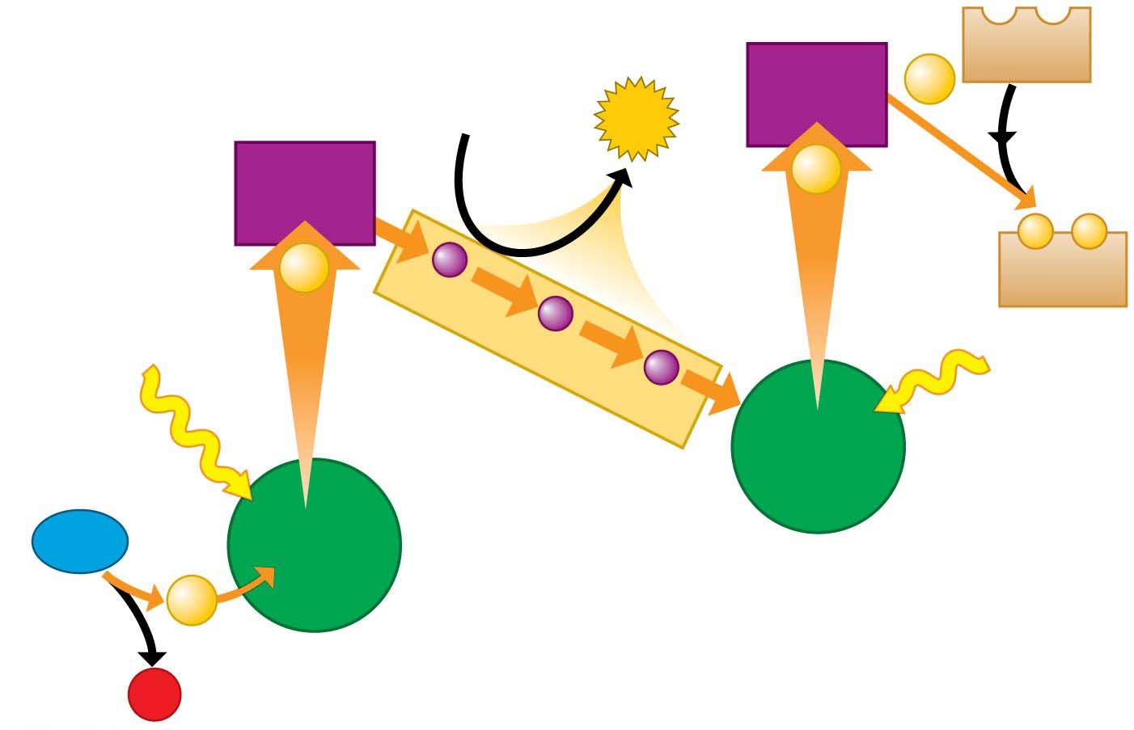
e⁻
acceptor
NADP⁺
2e⁻
ADP
ATP
e⁻
acceptor
2e⁻
−
−
2e⁻
NADPH
Photon
Electron transport chain
Photon
Chlorophyll
H₂O
Chlorophyll
Second photosystem
2e⁻
First photosystem
2 H⁺ +
1
2
O₂
Notes:
Figure 7.UN05 Summary of key concepts: photosystems

Slide 75
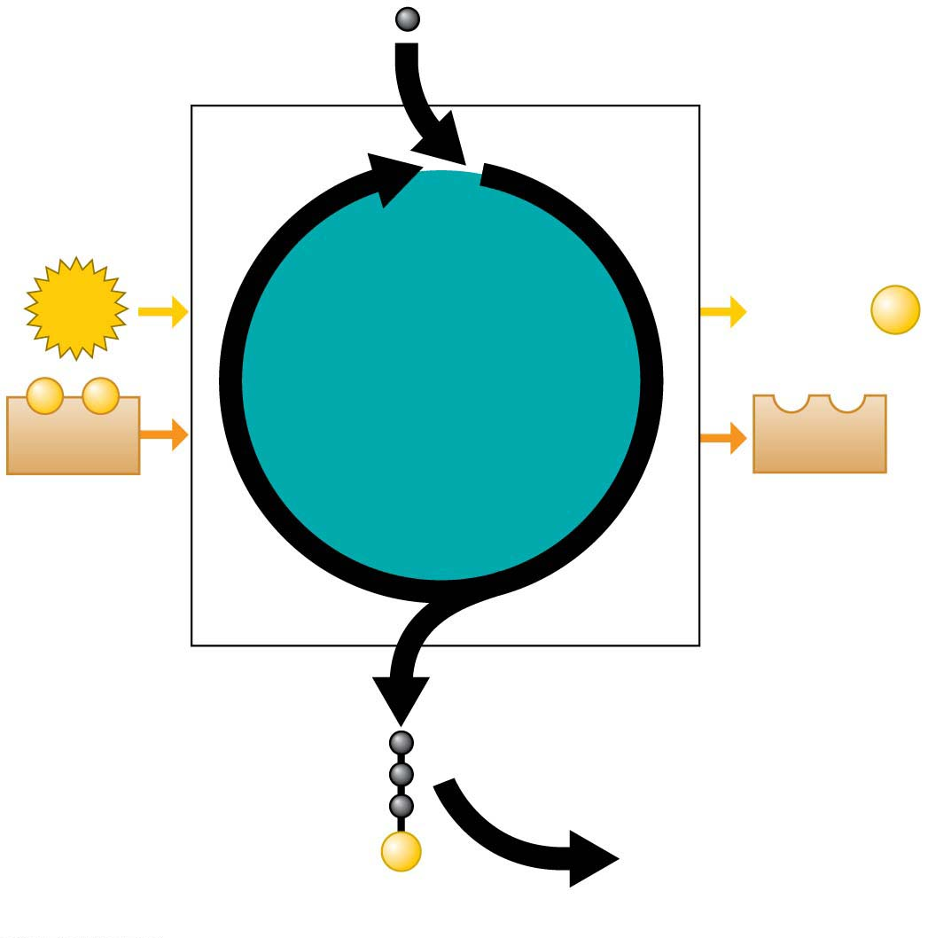
CO₂
ATP
Calvin
cycle
ADP
⁺
P
−
−
NADPH
NADP⁺
G3P
Glucose and
other compounds
(such as cellulose
and starch)
P
Notes:
Figure 7.UN06 Summary of key concepts: Calvin cycle

Slide 76
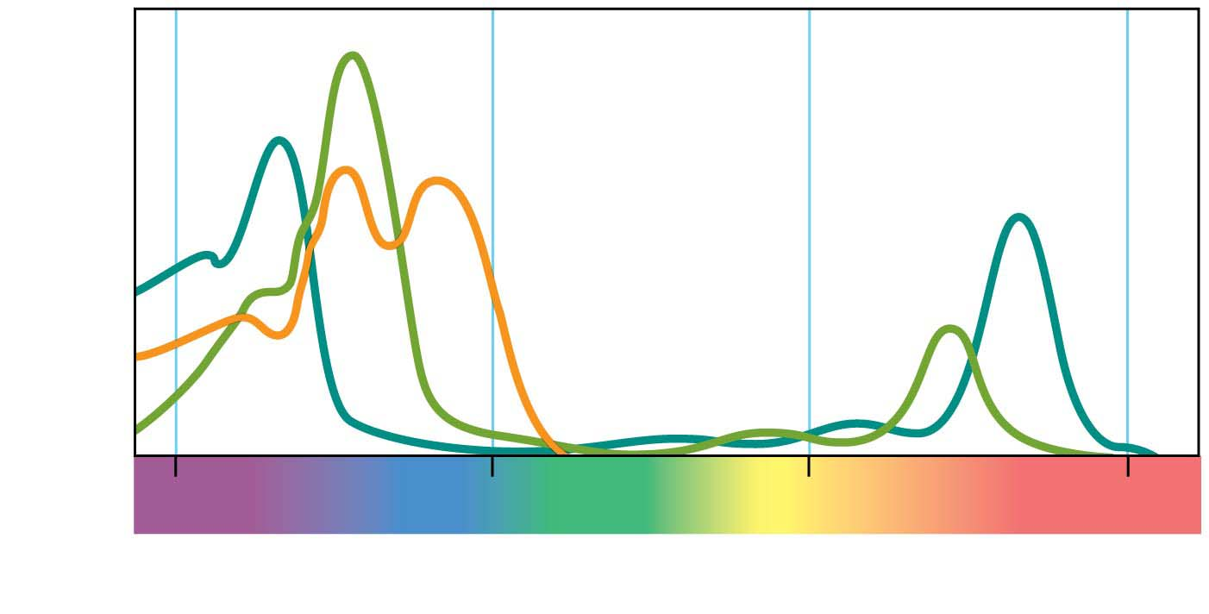
Chloro-
phyll a
Chlorophyll b
Absorption of light by
chloroplast pigments
Carotenoids
400
500
600
700
Wavelength of light (nm)
Notes:
Figure 7.UN07 Process of science, question 12 (absorption spectrum)

